Slide 1
Understanding Search Engines
Google Landing
Web Search Lesson Plan
Module A2
Notes:
Inquiry question: How does search work on the web?
Students will identify the basic parts of a web search engine search page.
Students will learn to "read" a web search results page.
Today we will learn the basic of how to use a search engine. We will be using Google.

Slide 2
Entering a Search
Do You Feel Lucky?

Slide 3
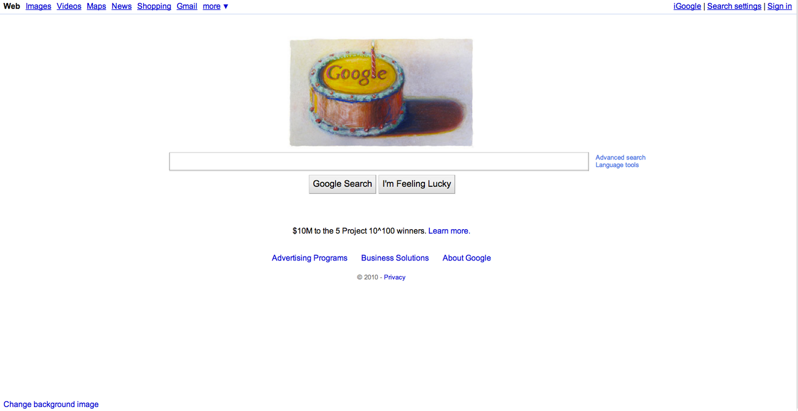
Homepage
Notes:
This is what the homepage looks like, you find it by entering google.com in the address bar of your browser.

Slide 4
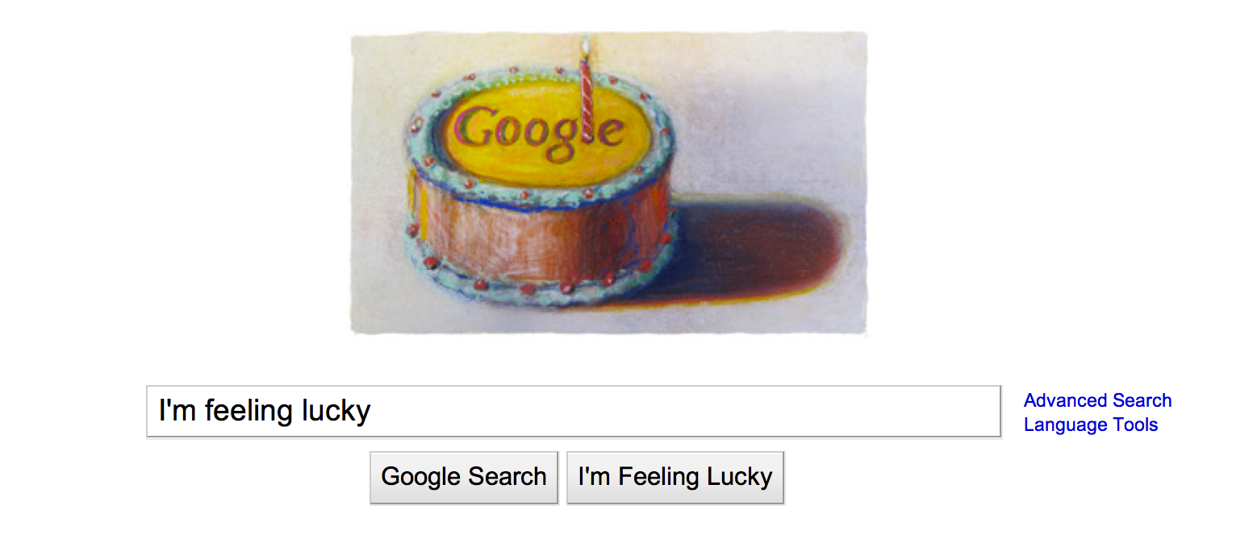
Say What You Want
A "query" is the word or phrase you search for in Google.
Enter your query here
Click this button
or hit "enter"
What happened?
Notes:
When you want to find information with Google, you click in the search box on the homepage.
You can tell you are there when you see your cursor blinking in the box.
Then, type the words you want to find into the search box like this. (Demonstrate in an open browser, if available)
When you are done, you can either click the button here that says "Google Search," or you can simply hit the "enter" button on your keyboard.
(You can open a browser such as Chrome, Firefox, or Safari and demonstrate where students might type a search into the browser's toolbar. In Chrome, you type both queries and addresses into the address bar. In other browsers, the long bar across the top of the browser is for entering addresses, and the smaller box--often in the upper right-hand corner--is for entering queries.)

Slide 5
Another Search Option
Try clicking "I'm Feeling Lucky."
What happened?
Notes:
Have students enter a simple query try the "I'm Feeling Lucky" button. Ask them to observe what happens.
Possible answer: I'm Feeling Lucky does not take me to search results, but takes me directly to the page that Google would give as my first result to the query I entered.

Slide 6
Different Search Tools
Have you used these?
Notes:
If you are looking for something that is not necessarily on a typical web page, you might want to click on one of these links and use one of Google's special search tools.
From here, you can go directly into Google Images, Google Books, etc. We'll talk about these tools in a later lesson.

Slide 7
Advanced Search
Visit the Advanced Search page. Enter a search using several of the search options offered there.
What do you notice?
Notes:
Show students the link to the Advanced search page, and take a quick look at the advanced search box. Together or individually, try using several of the boxes to run a more complex search.

Slide 8
Language Tools
Visit the Language Tools page and see what the different sections of the page do.
Try the Translate Search section. Visit Google in another country.
Where did you go?
Notes:
Point out the Languages Tools link on the Google homepage an click through to the Language Tools page.
Features include:
Translated search: search in English, Google translates the search to appropriate languages, translates results back into English, and gives them to you.
Translate text: Enter a phrase or more, and Google will translate it into the language you chose.
Translate a webpage: Give the web address of a page, and have the contents translated into the language of your choice.
Use the Google interface in your language: Operate Google in another language--but beware of changing it to something that you can't read so you can't find the link to change it back to English!
Visit Google's site in your local domain: Visit Google's search page for Japan, Peru, and over 180 different locales!
Together or individually, try translating a word or phrase, and click through to another country's Google homepage.

Slide 9
Reading Your Results
Search Engine Results Page

Slide 10
The Search Engine Results Page
Search bar
Left panel
Organic (natural) search results
Sponsored links (ads)
Notes:
Now that you have run a search, you need to understand how the search results page is laid out.
Introduce:
search bar
left panel (the subject of later lessons)
organic search results
sponsored links (ads)
As you click, each of these sections will be highlighted, and the next click will show the section's name.

Slide 11
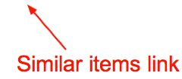
Reading Individual Search Results
Notes:
(1)
The first thing you see is the title.
The title for the page is usually decided by the person who created it.
Here, notice that the title tells us both the name of the page, "The Pesident's Job," and the name of the website from which it comes, "Scholastic.com."
(click)
(2)
The information in black underneath the title is called the snippet.
The snippet gives you a sense of what you will find on the page, and what it has to do with the search you entered.
This description was written by the website's author to help you understand what the page is about. Sometimes, Google shows you where your search term appears on the page, with a few words surrounding it to give you a sense of the context in which it appears.
(click)
(3)
Below the snippet, in green, is the web address. It is the address for the webpage that you will visit if you click on this result.
(click)
(4)
The cached link shows you exactly what this web page looked like when Google last visited it.
If you click on the cached link, you will see a copy of the page as it existed at that time.
This cached link is particularly helpful if the webpage has changed very recently and the information you want is no longer there.
You can just click on the cached link and see what it was that Google found the last time we visited the page.
You can also use the cached link if the page you want to visit is not functioning, or has been removed.
(click)
(5)
Finally, if you find that this page does a good job meeting your needs, you can click on the similar items link to find more pages that have similar content.

Slide 12
Give It a Try!
If you had a website, what would a search engine show about your site?
Write a fictional search result, complete with title, snippet, web address, and similar links.
Notes:
"Snippet" a fictional web site - Students write up search results, like they saw in [Slide #11], of a website about themselves or interview a class member and write up search results about a fictional web page a class member might have. Questions to ask: If they had a web site, what would a search engine show about their site? Include: title, snippet, URL and similar pages. Share student created fictional search results with class to determine understanding of search results and what they mean.

Slide 13
This lesson was developed by:
Tasha Bergson-Michelson
Trent Maverick
This lesson is licensed under a Creative Commons Attribution-Share-Alike license. You can change it, transmit it, and show it to other people. Just always give credit to Google.com ("Attribution"), and make sure that any works you make based on these lessons are also under the same Creative Commons Attribution-Share-Alike license ("Share-Alike").
http://creativecommons.org/licenses/by-sa/3.0/legalcode.

